Slide 2

Velocity estimation from Doppler radar
Mark Henney
02456 Deep Learning
Project #4

Slide 3
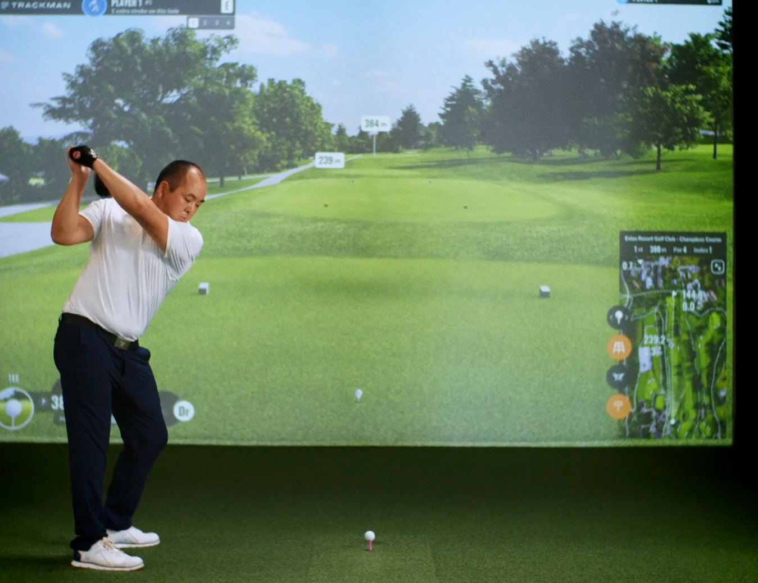
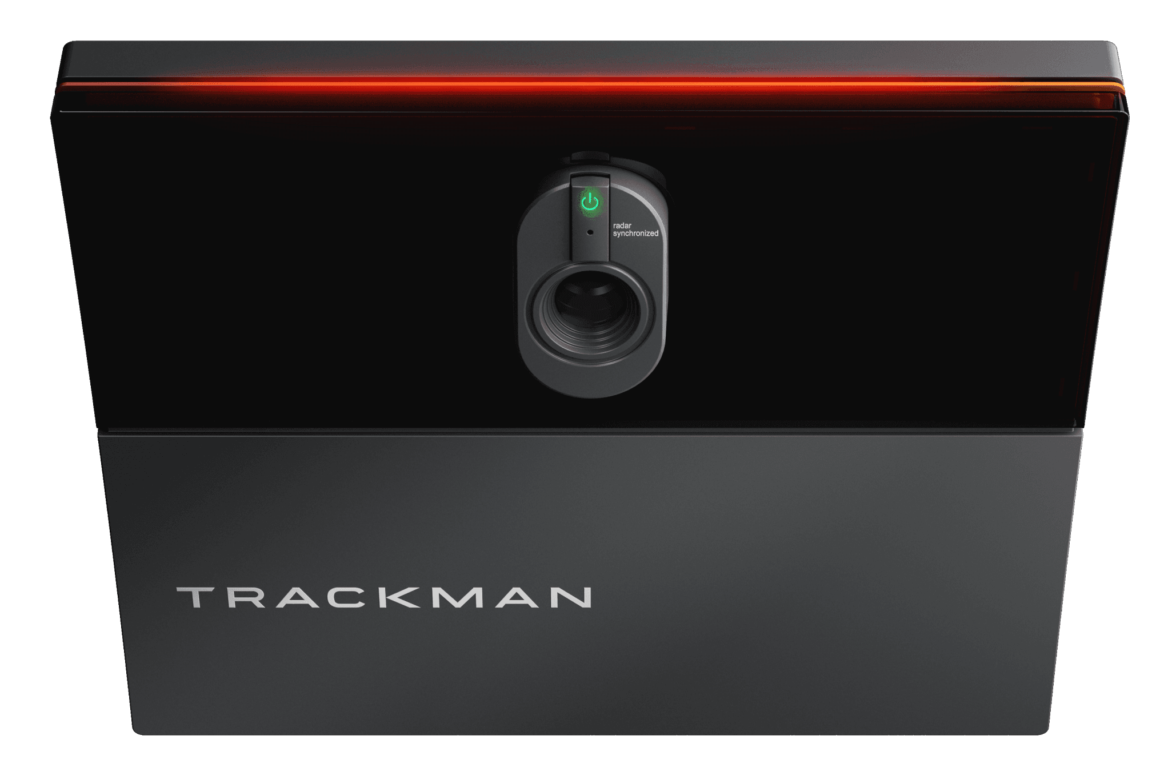
Context

Slide 4
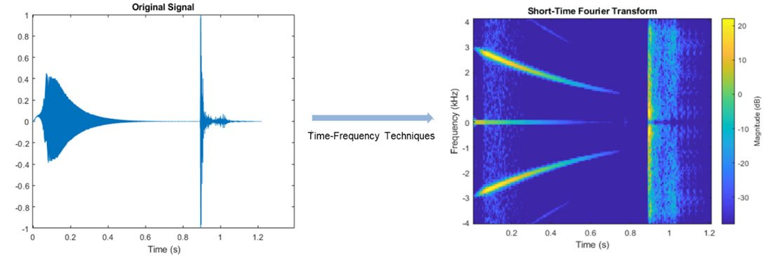
Context

Slide 5
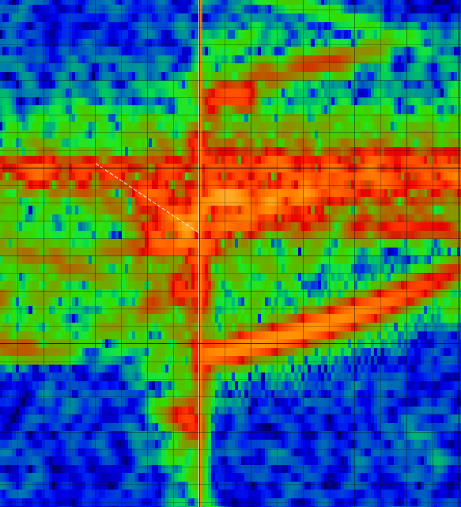
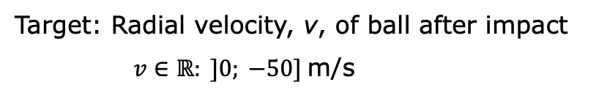
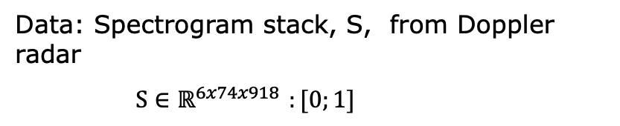
Problem statement
Velocity (from frequency)
Estimate the initial velocity of the golf ball after club impact.
0
Data: Spectrogram stack, S, from Doppler radar
$S∈ℝ^{6x74x918 }:[0;1]$
Target: Radial velocity, v, of ball after impact
$v∈ℝ: ]0; −50]$m/s
Time

Slide 6
Baseline model: Architechture
The vigilant student will notice that I defined this kernel wrong (i.e. not 5x5)

Slide 7
Baseline model: Performance

Slide 8
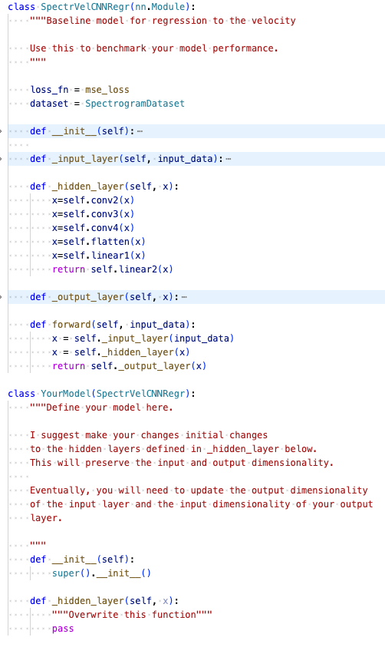
Suggested Approach
Your hidden layers

Slide 9
Modelling constraint
In an ideal world, we have infinite resources.
Engineers make things work with limited resources.
Modelling constraint: You are not allowed to add model complexity (#parameters)
I have written a little function for you to check your model complexity:
def print_model_complexity(model: Module) -> None:
"""Check and print the number of parameters in the network
Args:
model (module): Pytorch model class
"""
total_params = sum(p.numel() for p in model().parameters())
print(f"Number of parameters in model {model.__name__}: {total_params} = {'{:.2e}'.format(total_params)}")
Number of parameters in model SpectrVelCNNRegr:
38414929 = 3.84e+07

Slide 10
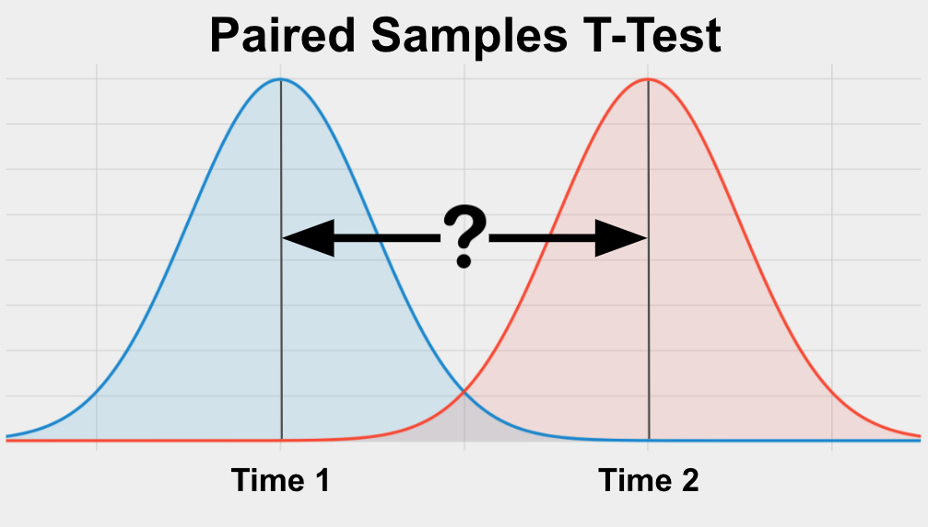
Goal
When communicating performance, you often compare your model to state-of-the-art (in this case, my model).
Beat my baseline model in test prediction MRSE (mean root-square error)
If you want to add scientific rigour to your findings, you can add a statistical test to compare the performances. A simple test would be a paired (by observation) t-test.
Distribution of prediction RSE
My Model
Your Model

Slide 11
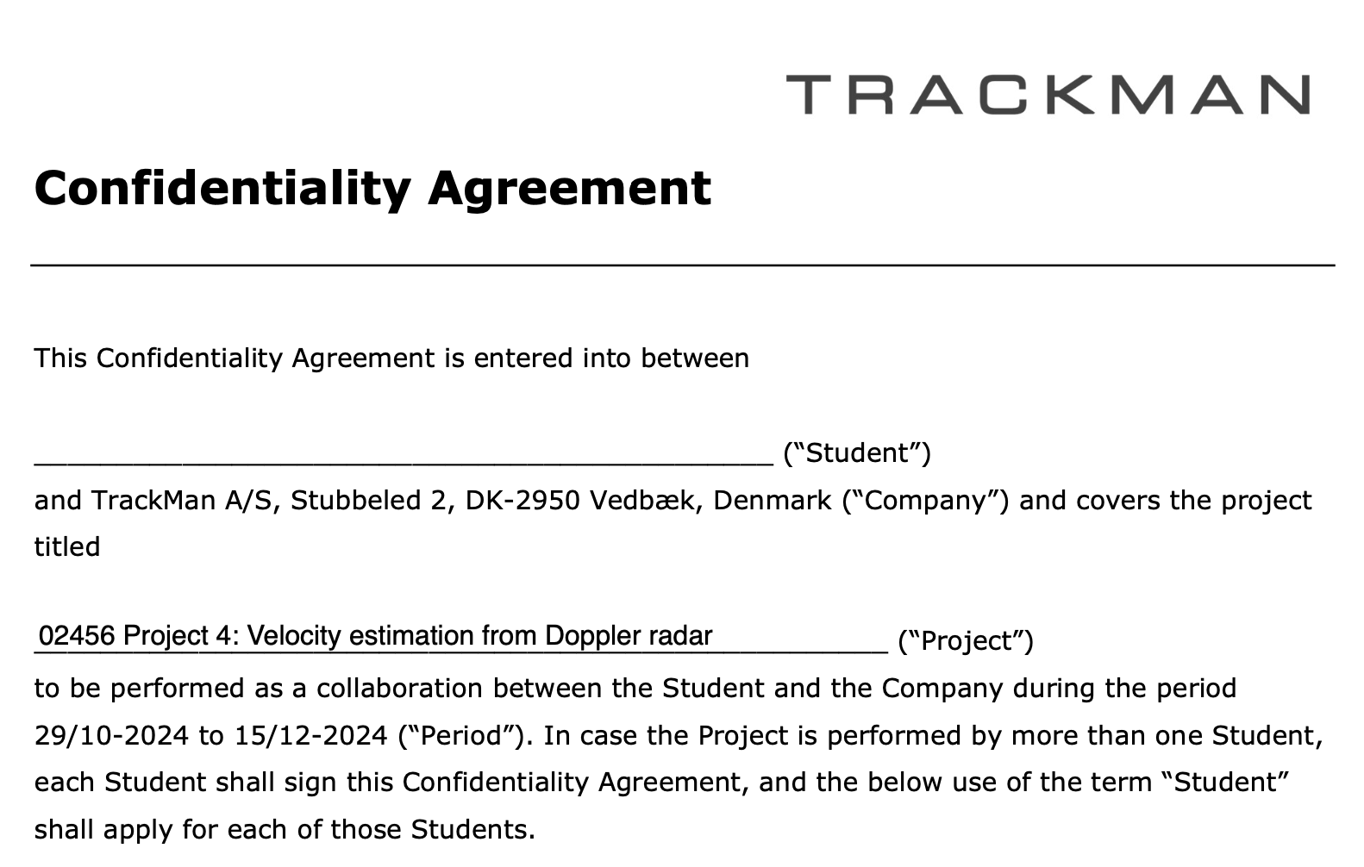
Data Access

Slide 12
Data Access
You will get read-only access to the /dtu-compute/maalhe/02456-p4-e24/ directory
Here you will find both a data/ directory and a scripts/
You will copy the scripts/ directory to your own user on the server
Use something like
cp /dtu-compute/maalhe/02456-p4-e24/scripts/ ~/my_project_dir/scripts/
Modify these as you like – just keep the absolute paths to the data directory the same
I might make changes/additions to the scripts/ directory during the next months in which case I will let you know

Slide 13
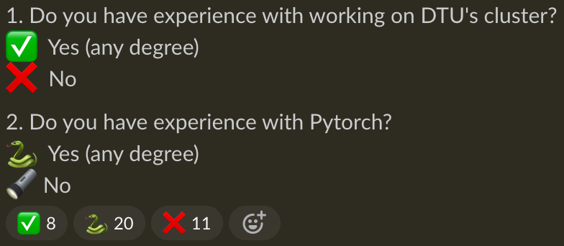
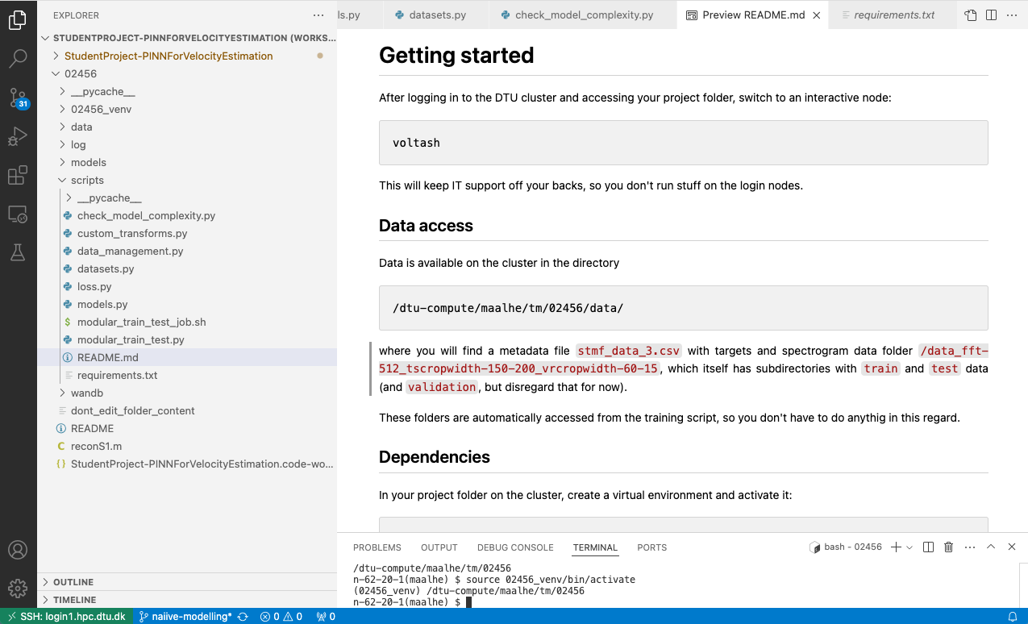
DTU Cluster and scripts

Slide 14
DTU Cluster and scripts

